Slide 1

Next-Generation Connectivity
Amazon MQ
Managed Message Broker Service for Distributed Applications

Slide 2
Modernizing Messaging Architecture
Transitioning from legacy on-premises brokers to fully managed cloud infrastructure without re-engineering application code.

Slide 3






VALUE PROPOSITION
Reduced Overhead
Interoperability
Rapid Migration
AWS manages provisioning, setup, software patching, and high availability maintenance automatically.
Supports industry-standard protocols including AMQP, MQTT, STOMP, OpenWire, and WSS.
Migrate existing applications easily using standard APIs like JMS and NMS with zero code changes.

Slide 4




SUPPORTED BROKER ENGINES
Apache ActiveMQ
RabbitMQ
The standard for classic enterprise messaging. Provides rich features like JMS 1.1/2.0 support and massive connectivity options across diverse languages.
Designed for low latency and high-throughput routing. Leverages the Erlang platform for robust clustering and distributed messaging patterns.

Slide 5


ENGINE DETAIL: ACTIVEMQ
Ideal for complex enterprise migrations requiring deep JMS integration.
Multi-protocol support (AMQP, MQTT, STOMP).
Durable storage with Amazon EFS.
Supports both Queues and Topics (Pub/Sub).
Advanced routing and filtering capabilities.

Slide 6

ENGINE DETAIL: RABBITMQ
Built for developers who prioritize sub-millisecond latency and advanced routing logic (exchanges, bindings).
Extremely high throughput.
Flexible routing patterns.
Native Erlang clustering.
Direct and Fanout exchanges.

Slide 7
ACTIVEMQ VS. RABBITMQ
Feature | Apache ActiveMQ | RabbitMQ
Primary Protocol | OpenWire / JMS | AMQP 0-9-1
Performance | Rich Features / Enterprise | Low Latency / High Throughput
Pub/Sub Support | Native Topics | Exchanges & Bindings
Cloud Storage | Amazon EFS / EBS | Instance Storage (EBS)

Slide 8



DEPLOYMENT ARCHITECTURE
Single Instance
Active/Standby
Clustered
Ideal for development, testing, and non-critical workloads. Minimal cost with full protocol support.
Standard for ActiveMQ HA. Redundant instances across AZs with synchronous data replication via EFS.
The high-availability model for RabbitMQ, utilizing a cluster of nodes for distributed messaging.

Slide 9




THE MESSAGING LIFECYCLE
Publish
Persist
Route
Ack
Producer sends message via AMQP/MQTT to the broker.
Broker writes message to Amazon EFS or EBS for durability.
Engine applies logic to send message to specific consumer.
Consumer acknowledges receipt; message is cleared from queue.

Slide 10
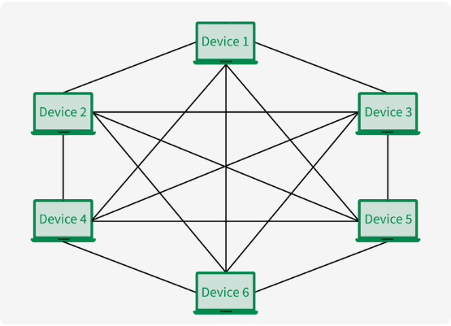
NETWORK OF BROKERS
A sophisticated architecture allowing multiple ActiveMQ brokers to interconnect, creating a massive, distributed mesh.
Global scalability across regions.
Intelligent load balancing.
Mesh and Hub-and-Spoke topologies.
Bridge connections between VPCs.

Slide 11

SECURITY & COMPLIANCE
Amazon MQ provides enterprise-grade security out of the box.
Encryption: Automatic encryption at rest (KMS) and in transit (TLS).
Isolation: Brokers run inside your Private VPC for isolation.
Access Control: Fine-grained IAM permissions for API operations.
Auditability: Integrated with CloudTrail and CloudWatch Logs.

Slide 12
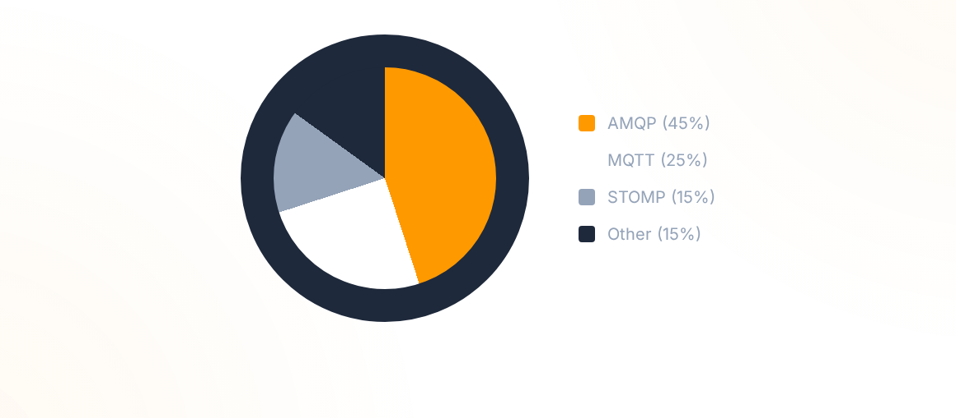
PROTOCOL DISTRIBUTION
AMQP remains the dominant standard for cross-language interoperability in enterprise clouds.

Slide 13

MQ VS. SQS VS. SNS
Use Amazon MQ when you need industry protocols or complex routing. Use SQS for hyper-scale cloud-native queues.

Slide 14
MIGRATION IMPACT
0
99.9%
CODE CHANGES
SLA AVAILABILITY
Seamlessly transition from on-premises IBM MQ, Tibco, or self-managed brokers with industry-standard stability.

